Slide 1

Neural Network
Dr. Linrui Zhang
University of Central Missouri

Slide 2
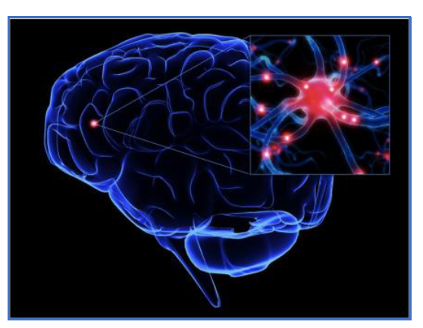
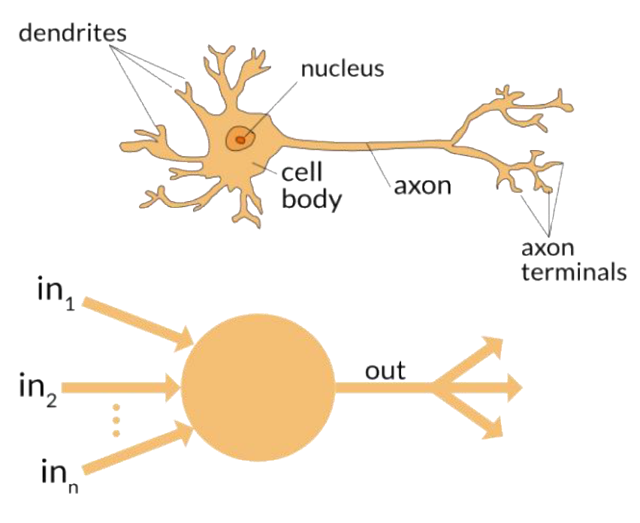
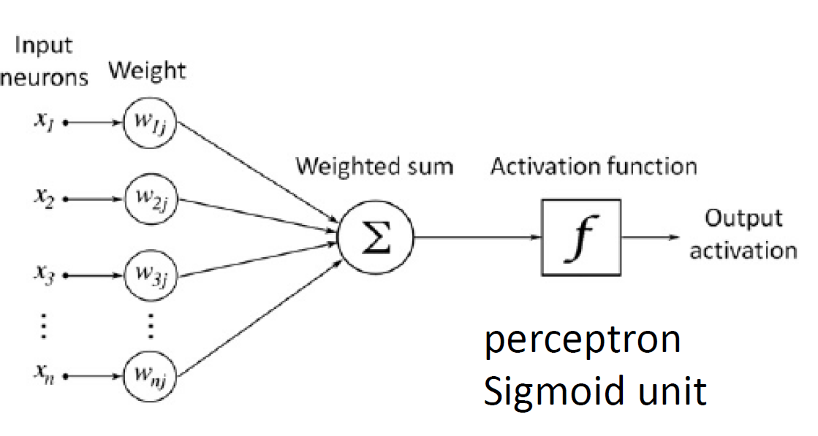
Perceptron

Slide 3
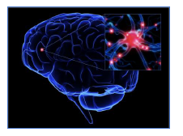
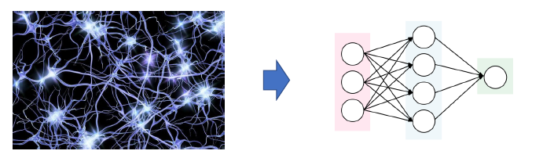
Neural Networks

Slide 4
Why Neural Network
+
-
x₂
x₁

Slide 5
Neural Networks
5x₁ – 2x₂ – 8
x₂
Non-Linearly Separable
We need to linear classifiers
5x₁ – 2x₂ – 8
7x₁ - 3x₂ - 1
7x₁ - 3x₂ - 1
x₁
5
x₂
-2
h
-8
1
x₁
x₁
7
x₂
-3
h
-1
1

Slide 6
Neural Networks
5x₁ – 2x₂ – 8
x₂
x₁
5
x₂
-2
h
-8
7
7x₁ - 3x₂ - 1
1
h
x₁
5
7
x₂
-3
h
-1
x₁
1
-6
1

Slide 7
Neural Networks
x₁
5
x₂
-2
h
x₁
5
-8
7
1
7
h
7
h
x₂
-2
h
-3
5
x₁
5
-8
7
h
1
-1
-6
x₂
-3
h
-1
-6
1
1
1

Slide 8
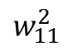
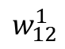
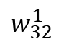
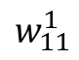
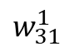
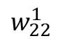
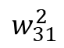
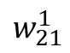
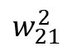
Neural Networks -- Representation
x₁
$$w_{11}^{1}$$
Weights
$$w_{12}^{1}$$
h₁
$$w_{11}^{2}$$
$$w_{21}^{1}$$
x₂
$$w_{22}^{1}$$
h
$$w_{21}^{2}$$
$$w_{31}^{1}$$
f non-linearity
h₂
$$w_{32}^{1}$$
$$w_{31}^{2}$$
Output Layer
1
1
Input Layer
Hidden Layer

Slide 9
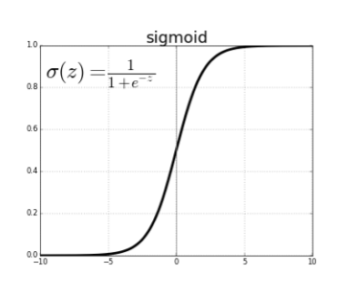
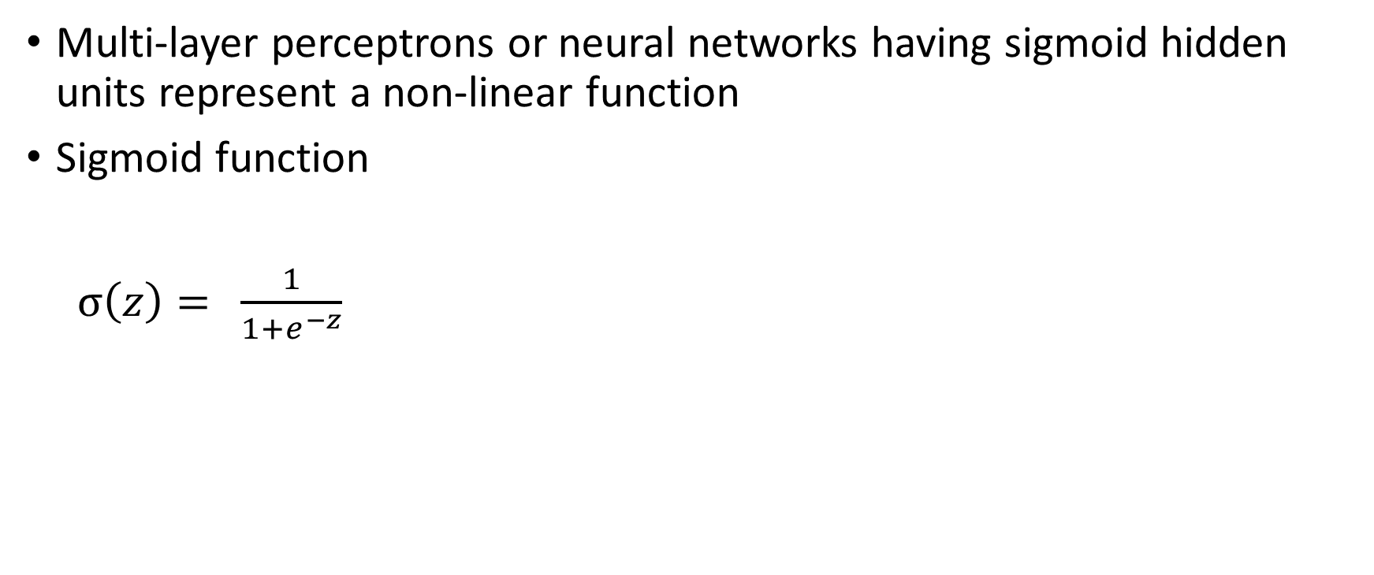
Non-linearity (Activation Function)
Multi-layer perceptrons or neural networks having sigmoid hidden units represent a non-linear function
Sigmoid function
$σ\left(z\right)=$ $\frac{1}{1+e^{−z}}$

Slide 10
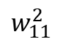
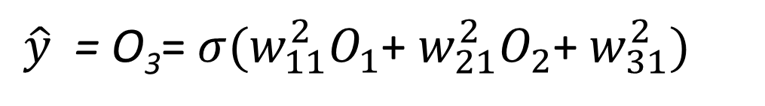
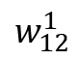
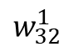
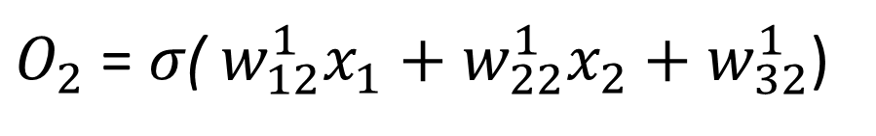
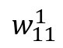
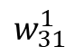
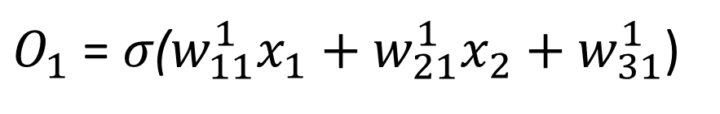
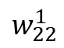
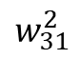
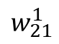
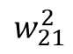
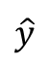
Forward Propagation
x₁
$$w_{11}^{1}$$
$O_{1}$ = ${σ\text{(}w}_{11}^{1}x_{1}+w_{21}^{1}x_{2}+w_{31}^{1}$)
$$w_{12}^{1}$$
O₁
h₁
$O_{2}$ = $σ\text{(} w_{12}^{1}x_{1}+w_{22}^{1}x_{2}+w_{32}^{1}$)
$$w_{11}^{2}$$
$$w_{21}^{1}$$
x₂
O₃
$\hat{y}$ = O₃= ${σ(w}_{11}^{2}O_{1}$+ $w_{21}^{2}O_{2}$+ $w_{31}^{2})$
$$w_{22}^{1}$$
h
$$\hat{y}$$
$$w_{21}^{2}$$
O₂
$$w_{31}^{1}$$
h₂
$$w_{32}^{1}$$
$$w_{31}^{2}$$
1
1

Slide 11
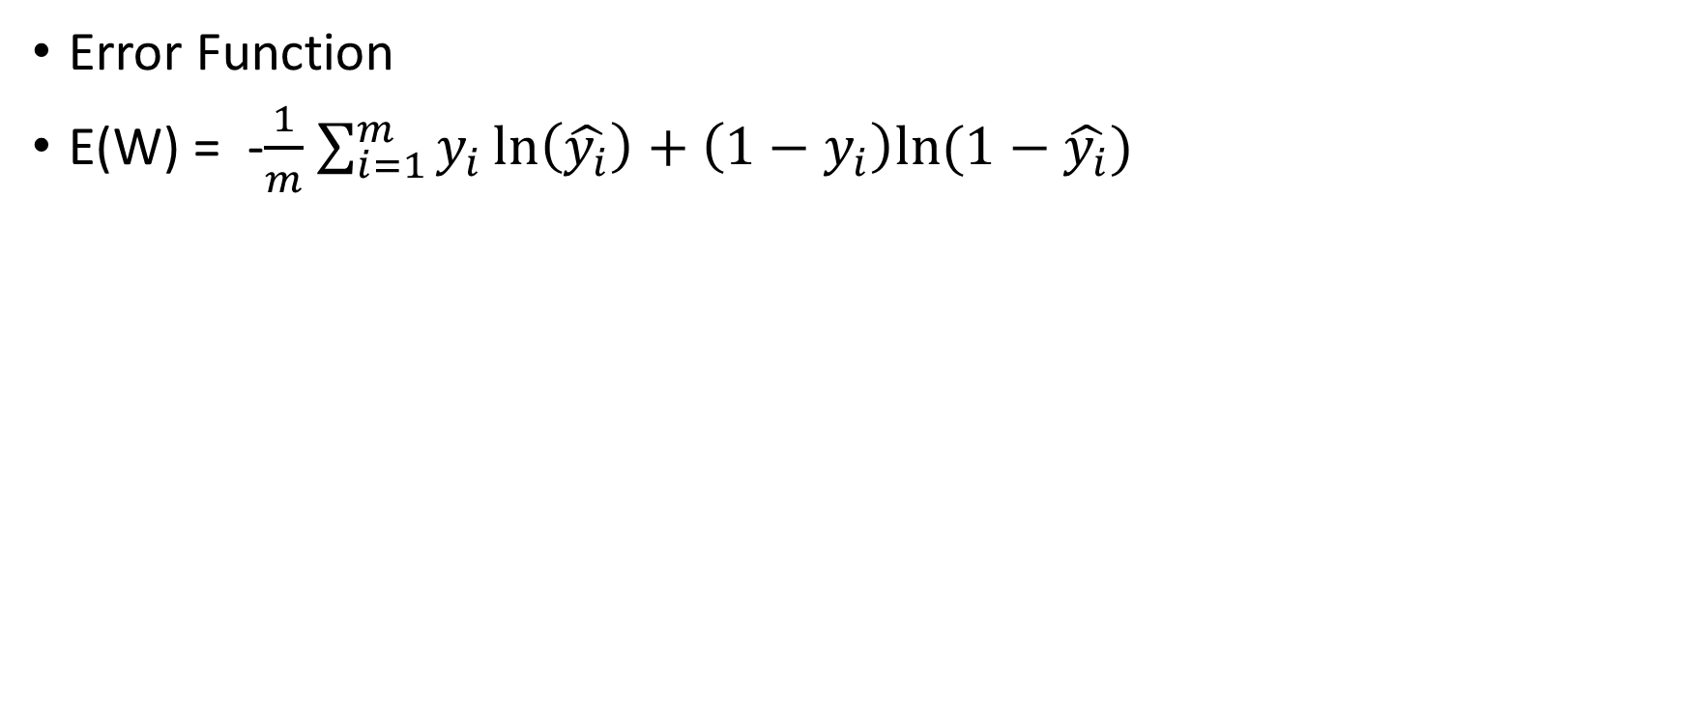
Neural Networks -- Evaluation
Error Function
E(W) = -$\frac{1}{m}$ $\sum_{i=1}^{m}{y_{i}\ln\left(\hat{y_{i}}\right)+\left(1−y_{i}\right)ln⁡(1−\hat{y_{i}})}$

Slide 12
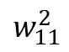
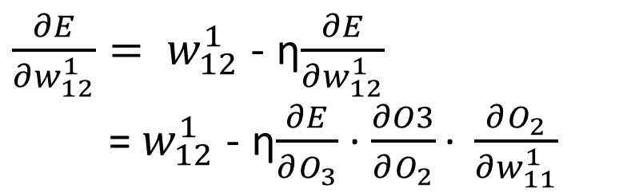
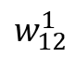
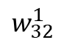
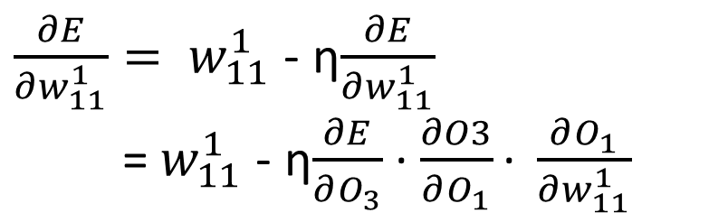
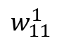
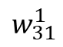
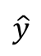
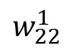
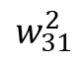
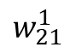
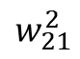
Neural Networks -- Evaluation
Gradient Descent
x₁
$$w_{11}^{1}$$
$\frac{∂E}{∂w_{11}^{1}}= w_{11}^{1}$ - η$\frac{∂E}{∂w_{11}^{1}}$
= $w_{11}^{1}$ - η$\frac{∂E}{∂O_{3}}$ ∙ $\frac{∂O3}{∂O_{1}}\text{∙ }\frac{∂O_{1}}{∂w_{11}^{1}}$
$$w_{12}^{1}$$
O₁
h₁
$$w_{11}^{2}$$
$$w_{21}^{1}$$
x₂
O₃
$$w_{22}^{1}$$
h
$$\hat{y}$$
$$w_{21}^{2}$$
$\frac{∂E}{∂w_{12}^{1}}= w_{12}^{1}$ - η$\frac{∂E}{∂w_{12}^{1}}$
= $w_{12}^{1}$ - η$\frac{∂E}{∂O_{3}}$ ∙ $\frac{∂O3}{∂O_{2}}\text{∙ }\frac{∂O_{2}}{∂w_{11}^{1}}$
O₂
$$w_{31}^{1}$$
h₂
$$w_{32}^{1}$$
$$w_{31}^{2}$$
1
1
… …

Slide 13
Recall the chain rule
In calculus, the chain rule is a formula that expresses the derivative of the composition of two differentiable functions f and g in terms of the derivatives of f and g.
More precisely, if ℎ (x) ∘ g(x) is the function such that ℎ(x) = f (g(x)) for every x, then the chain rule is, in Lagrange's notation, ℎ′(x) = f′(g(x))g′(x)

Slide 14
Occam’s Razor
How many hidden layers?
Entities should not be multiplied beyond necessity
The simplest explanation is usually the best one

Slide 15
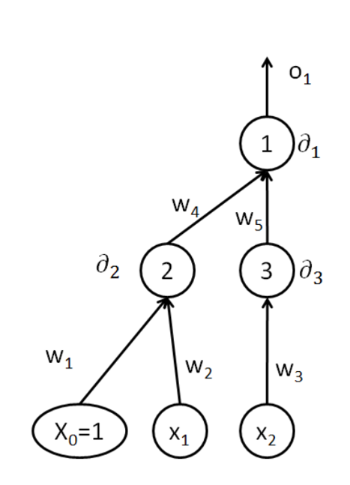
Example
Consider the neural network given below:
Assume that all internal nodes compute the sigmoid function. Write an explicit expression to how back propagation changes the values of w₁, w₂, w₃, w₄ and w₅ when the algorithm is given the example x₁ = 0, x₂= 1, with the desired response y = 0. Assume that the learning rate is α and that the current values of the weights are : w₁= 3, w₂ = 2, w₃=2, w₄ = 3 and w₅ = 2. Let o_{j} be the output of the hidden units and output units indexed by j.

Slide 16
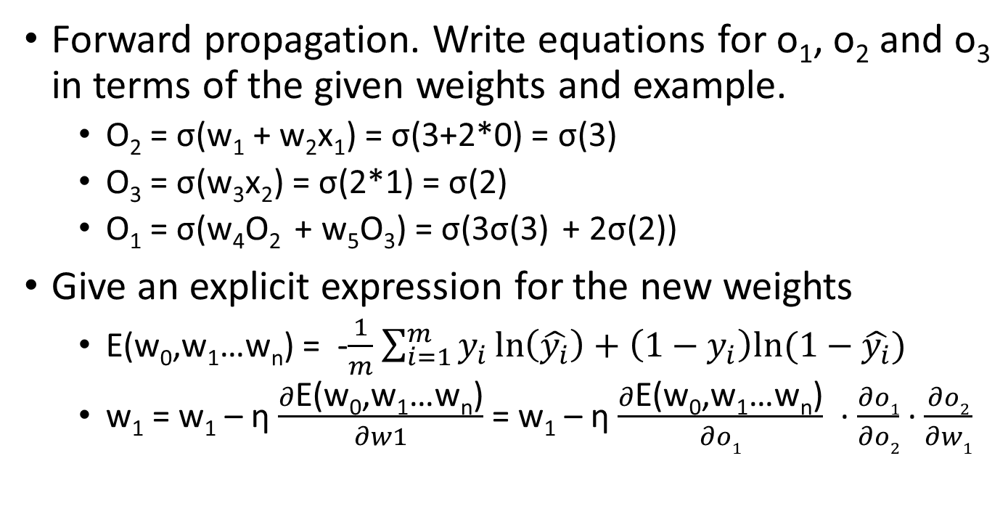
Example
Forward propagation. Write equations for o₁, o₂ and o₃ in terms of the given weights and example.
O₂ = σ(w₁ + w₂x₁) = σ(3+2*0) = σ(3)
O₃ = σ(w₃x₂) = σ(2*1) = σ(2)
O₁ = σ(w₄O₂ + w₅O₃) = σ(3σ(3) + 2σ(2))
Give an explicit expression for the new weights
E(w₀,w₁…w_{n}) = -$\frac{1}{m}$ $\sum_{i=1}^{m}{y_{i}\ln\left(\hat{y_{i}}\right)+\left(1−y_{i}\right)ln⁡(1−\hat{y_{i}})}$
w₁ = w₁ – η $\frac{∂\text{E}\text{(}\text{w}\text{0}\text{,}\text{w}\text{1}\text{…}\text{wn}\text{)}}{∂w1}$ = w₁ – η $\frac{∂\text{E}\text{(}\text{w}\text{0}\text{,}\text{w}\text{1}\text{…}\text{wn}\text{)}}{∂o1}$ ∙ $\frac{∂o1}{∂o2}$ ∙ $\frac{∂o2}{∂w1}$

Slide 17
Quiz Time
For the previous question, give an explicit expression for the new weights w₂ and w₄

